Slide 1

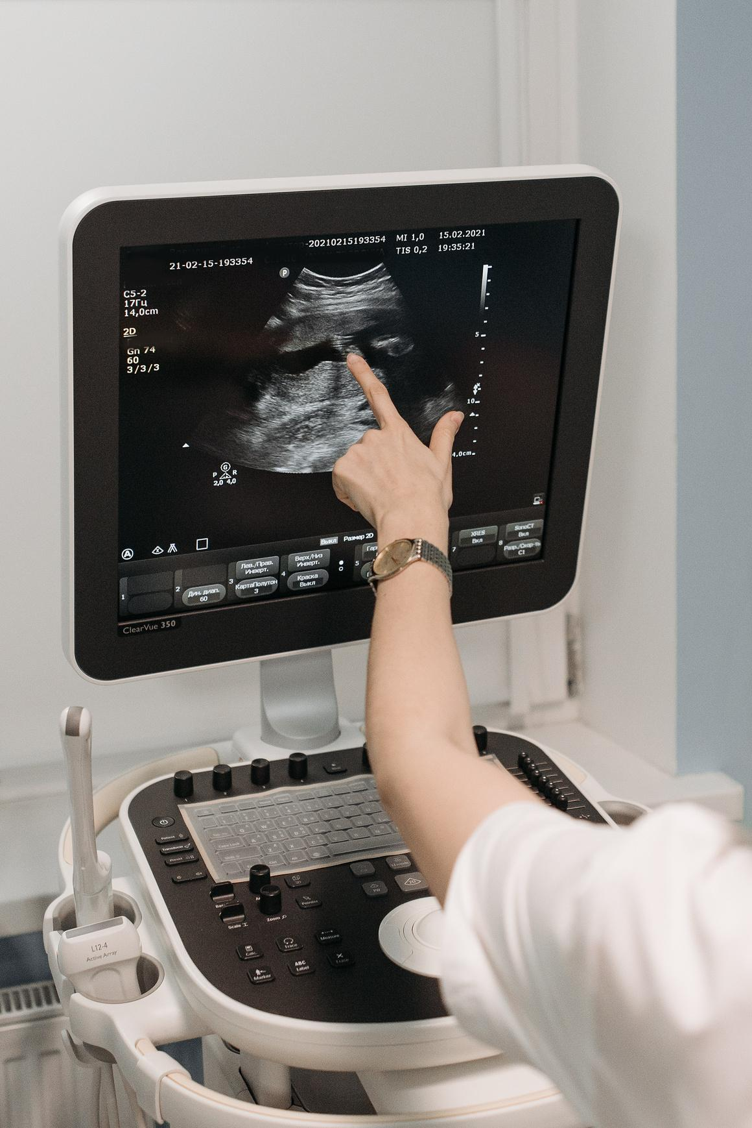
FETAL RISK CLASSIFICATION USING CTG DATA:
A MACHINE LEARNING APPROACH
Edith Gómez
Sarah Peña
Elier Fajardo
March 2024

Slide 2
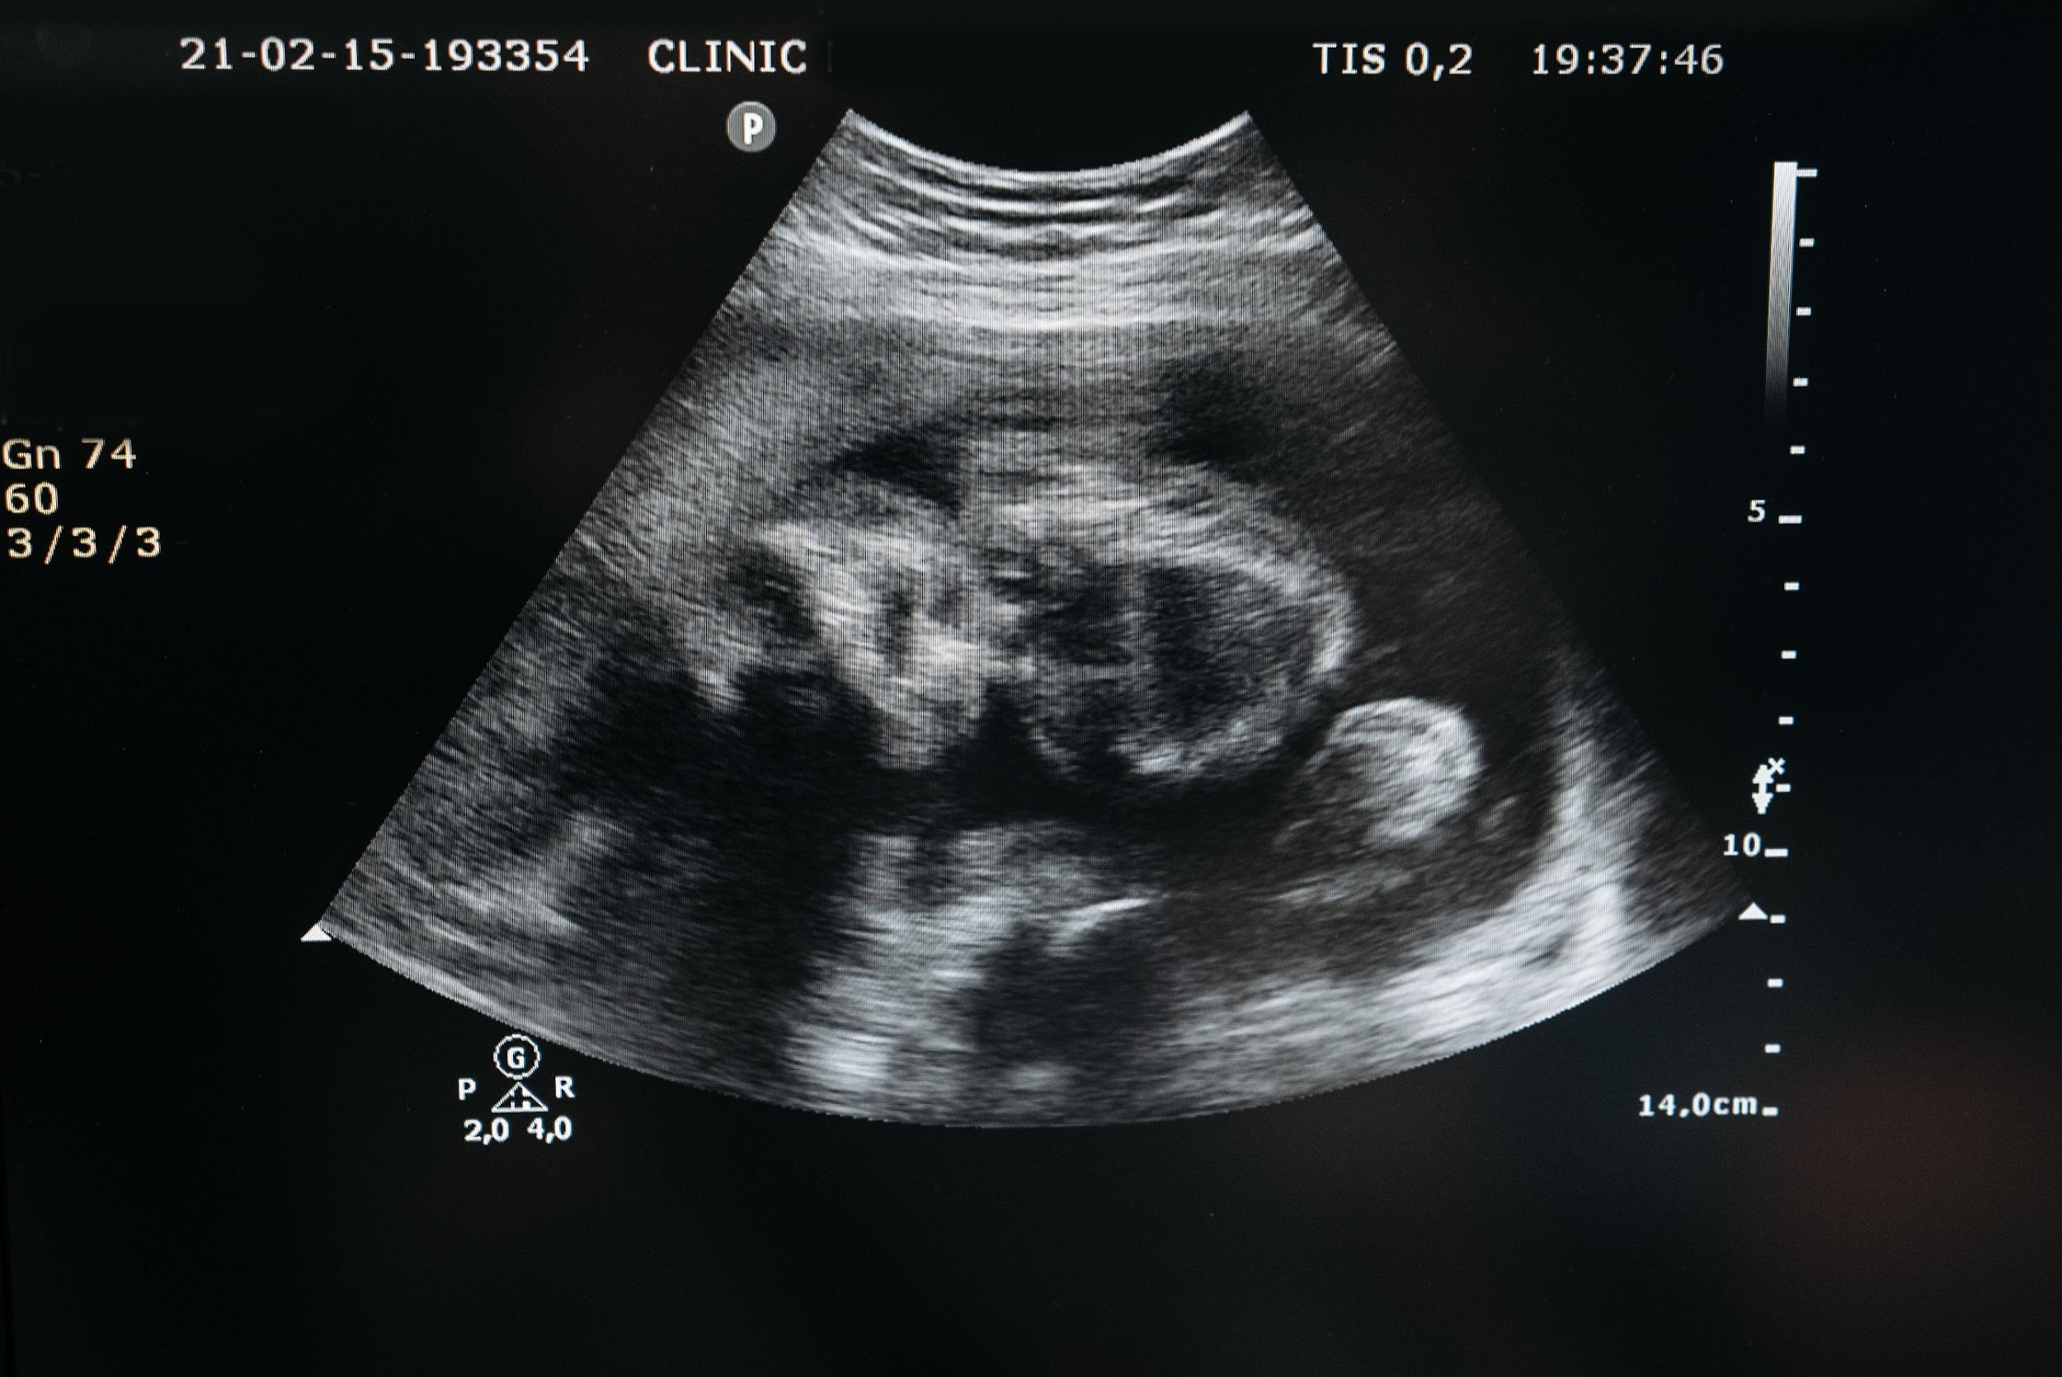


PROJECT OVERVIEW
Reducing child mortality rates stands as a paramount objective within the global health agenda. By 2030, nations aspire to eradicate preventable deaths among newborns and children under the age of five. Concurrently, maternal mortality remains a concerning issue, claiming 295,000 lives during and post-pregnancy in 2017.
The convergence of health complications during gestation as a global concern underscores the urgency for innovative solutions. Machine learning (ML) algorithms offer promising avenues for predicting fetal health based on cardiotocographic (CTG) data, categorizing health states into normal, needing assurance, or indicative of pathology.

Slide 3


PROJECT PIPELINE
Data Collection
Kaggle dataset repository
Data Preprocessing
Handling of data duplicates, scaling
Visualization of data distribution, variable correlation, class balance, class differences respect to other variables.
EDA
Four models were trained and evaluated: dummy classifier, logistic regression, random forest, and a neural network.
Model Training and Evaluation
Conclusions
Model performance comparison and insights obtained from the experiments.

Slide 4

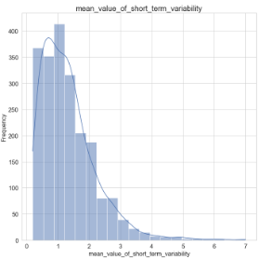
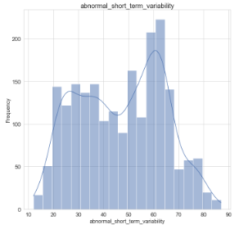
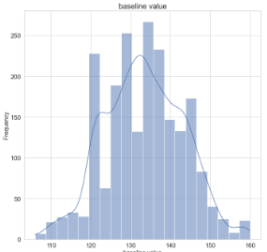
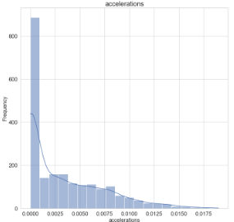
Exploratory Data Analysis
In first place, we observed the distribution of the variables of the dataset. We identified that some features present skewness in their distribution, others show a normal-like distribution.
To deal with these differences, we performed data scaling.

Slide 5

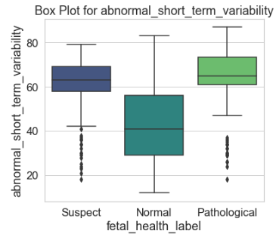
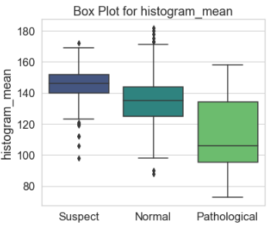
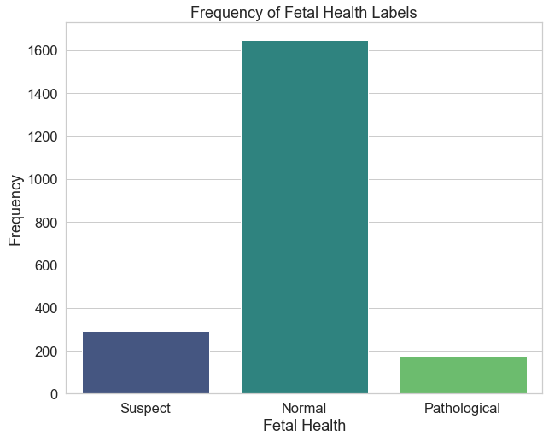
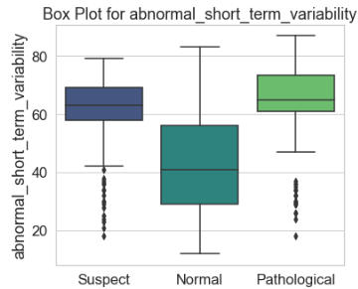
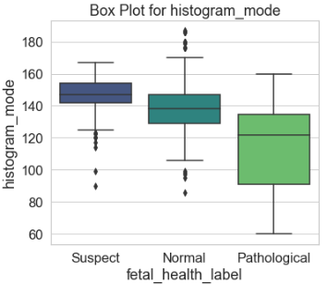
Exploratory Data Analysis
We observed the distribution of the target classes among multiple classes. We found out significant differences among some features, as well as class imbalance in the dataset.

Slide 6

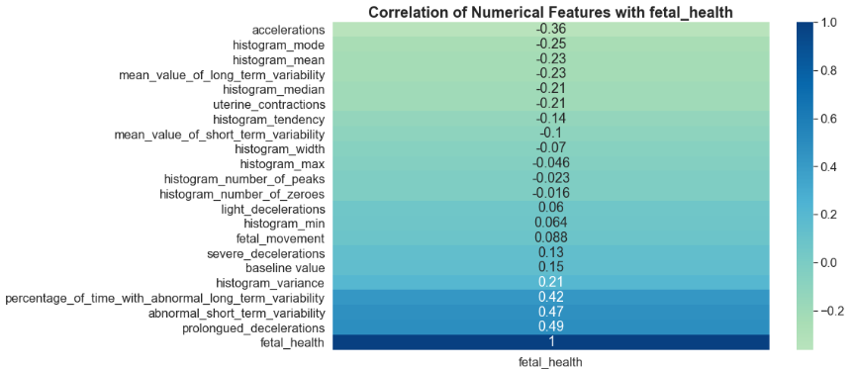
CORRELATIONS WITH TARGET VARIABLE
By looking at the correlation coefficients of the features and the target variable fetal_health, we see that three features have a linear correlation larger than 0.40. This significant correlation underscores the potential impact of these features on predicting fetal health outcomes, highlighting their importance in our machine learning approach for fetal risk classification.

Slide 7

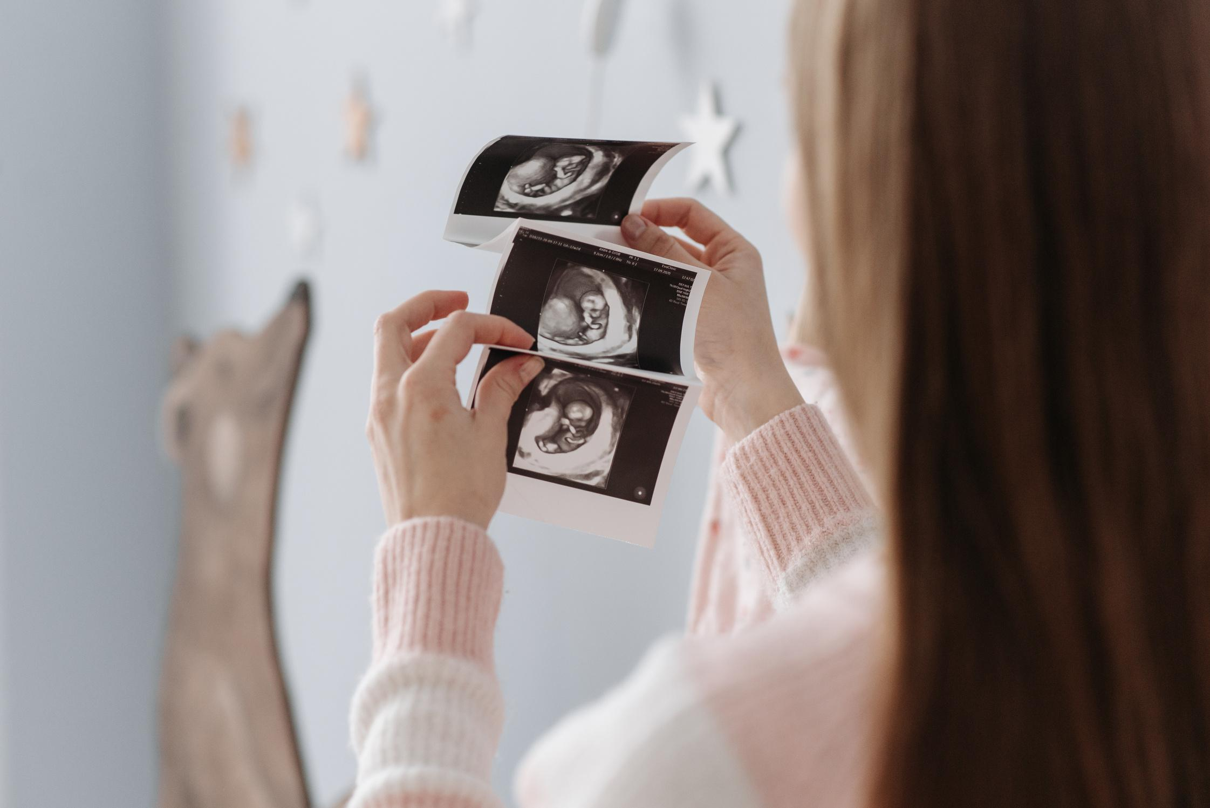
MODEL TRAINING AND EVALUATION
80%
TRAINING
20%
TEST
To optimize our models, hyperparameters are tuned using GridSearchCV. We rigorously evaluate the selected model using ten-fold cross-validation to ensure precise performance evaluation, independent of random data partitions that may influence metrics.
Finally, the best-performing model is saved using the pickle library for future use and deployment.

Slide 8
RESULTS
After running all experiments, it is clear to see that the Neural Network model performs generally better at classifying the data instances.
Model | Balanced Accuracy | F1 Score | Precission
Baseline Model | 35.0% | 27.0% | 81.0%, 16%, and 6% for 'Normal', 'Suspect', and 'Pathological' classes respectively.
Logistic Regression | 68.60% | 69.75% | Ranged from 60% to 82% for different health classes
Random Forest | 71.82% | 75.10% | 84.46%, 66%, and 87% for 'Normal', 'Suspect', and 'Pathological' classes respectively.
Neural Network | 92.11% | 85.16% | Demonstrated robust performance in accurately classifying fetal health conditions across different health categories.

Slide 9

CONCLUSIONS
In comparing the performance of the three models, Logistic Regression served as a foundational approach, offering initial insights but demonstrating relatively lower performance metrics. On the other hand, the Random Forest model surpassed Logistic Regression, demonstrating robust performance across various evaluation metrics. However, the Neural Network emerged as the standout performer, showcasing superior accuracy and predictive capability, thus highlighting its effectiveness in accurately classifying fetal health conditions.

